Slide 1
Code Quality and Code Reviews
Steven Yeh - 07/29/2021

Slide 2
Agenda
Code Quality
What is Quality Code
How do we measure it?
Code “Smells”
Stepping through examples
Testing
Code Reviews
What to do when asking for code reviews
What to look for in other developers code
Conversational Reviews
How to ask for feedback constructively
How to address feedback efficiently

Slide 3
Code Quality

Slide 4
What is Quality Code
5 Core Tenets
Reliability - Probability of failure
Maintainability - Easy to understand, easy to modify, enhance
Testability - How well testing efforts are supported
Reusability - Can it be used again, loosely coupled
Portability - Can it run in multiple environments
These line up with our outcomes

Slide 5
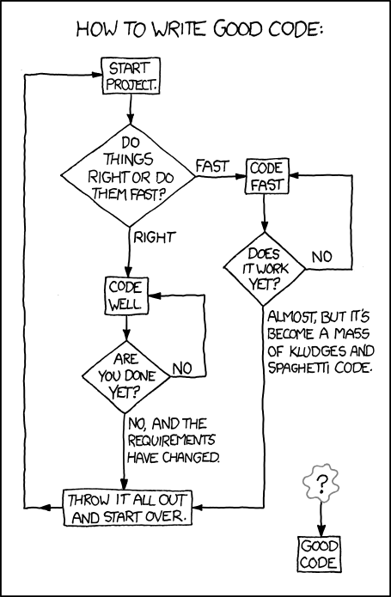
Why is Quality Code Important
Hardest to Unwrite Code - Code in Production is harder to apply fixes to
We don’t know what changes will be needed in the future or who will be making the changes
Always cheaper to “fix it now” than “fix it later”

Slide 6
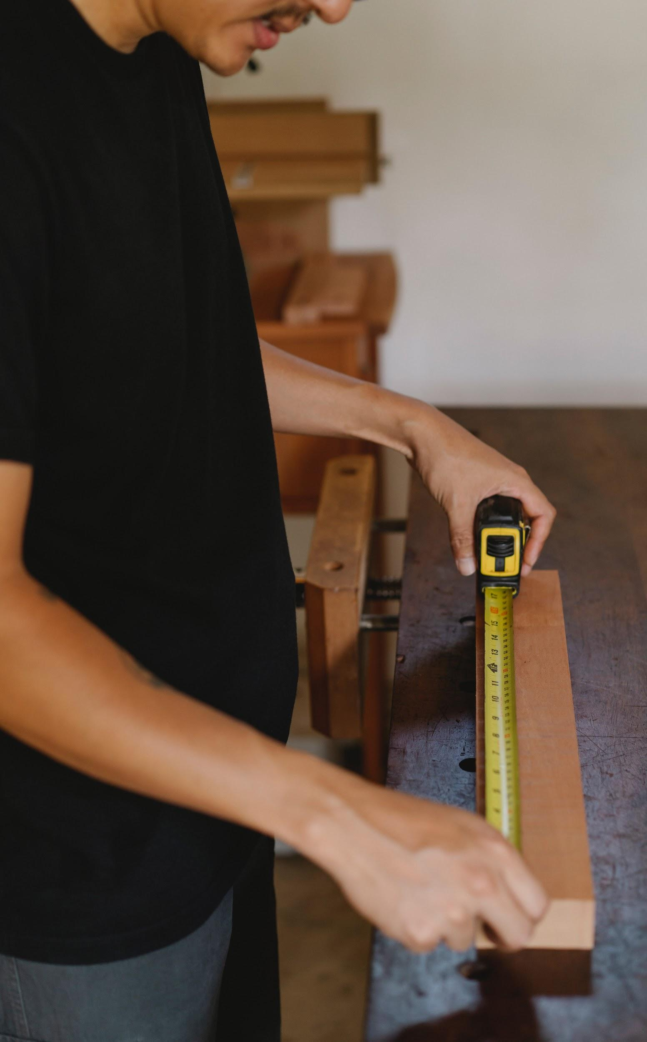
Measuring Code Quality
Defect Metrics
Defect source
Open defects
MTTR - Time to identify and fix defects
Defect Density
Complexity Metrics
Program vocabulate
Program Length
Volume
Difficulty
Effort

Slide 7
Code Smells
What: Subjective - Varies by language, developer, team
Definition: Smells are certain structures in the code that indicate violation of fundamental design principles and negatively impact design quality
Notes:
What: Subjective - Varies by language, developer, team
Definition: Smells are certain structures in the code that indicate violation of fundamental design principles and negatively impact design quality

Slide 8
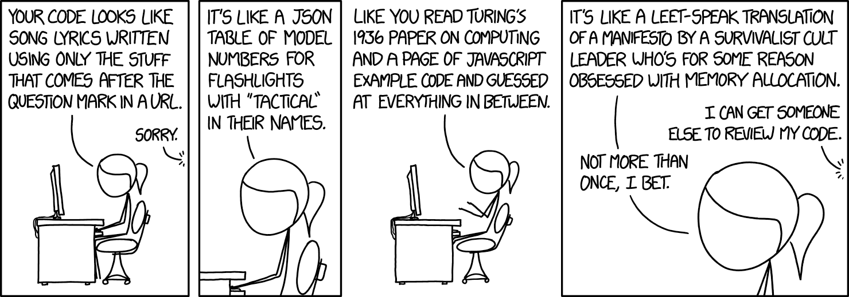
DEMO

Slide 9



Some Clean Code Principles
Scout Rule
DRY: Don’t Repeat Yourself
SOLID
Single-Responsibility Principle (SRP)
Open-Closed Principle (OCP)
Liskov Substitution Principle (LSP)
Interface Segregation Principle (ISP)
Dependency Inversion Principle (DIP)
Notes:
Single-Responsibility Principle (SRP)
A class should have one and only one reason to change
Open-Closed Principle (OCP)
Software Entities should be open for extension but close for modification
You should not need to modify the code you have already written to accommodate new functionality, but simple add what you now need
Liskov Substitution Principle (LSP)
Functions that use pointers or references to base classes must be able to use objects of derived classes without knowing it
Derived classes must be substitutable for their base classes
Interface Segregation Principle (ISP)
Many client-specific interfaces are better than one general-purpose interface
Make fine grained interfaces that are client specific.
Dependency Inversion Principle (DIP)
Abstractions should not depend on details. Details should depend on abstraction. High-level modules should not depend on low-level modules. Both should depend on abstractions
Depend on abstractions, not on concretions.

Slide 10
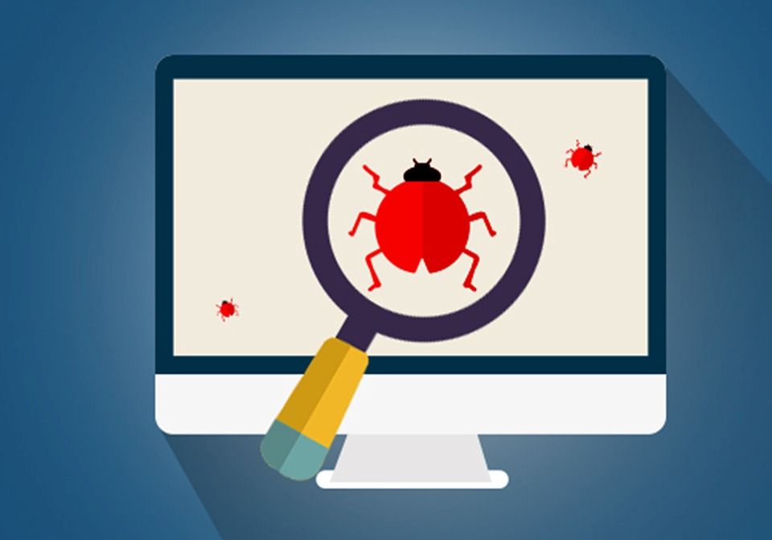
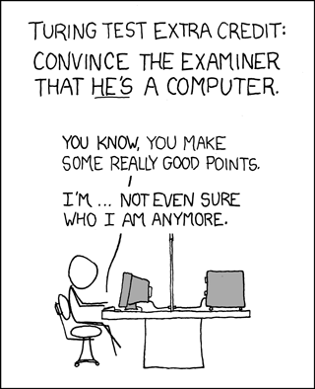
Testing
Types
Unit Testing
Integration Testing
Visual Testing
End to End Testing
Performance Testing
Acceptance Testing
Measuring
Statement Coverage
Branch Coverage
Function Coverage
Lines Coverage

Slide 11
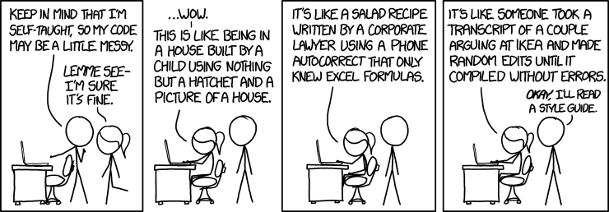
How to Improve
Coding Standards
Analyze Code
Code Reviews
Refactor Legacy Code
100%
100%
100%
80%
80%
80%
60%
60%
60%
40%
40%
40%
20%
20%
20%
0%
0%
0%
Q1
Q2
Q3
Q4
Q1
Q2
Q3
Q4
Q1
Q2
Q3
Q4
2015
2016
2017

Slide 12
Final Notes
“Any fool can write code that a computer can understand. Good programmers write code that humans can understand” - Martin Fowler
“When you feel the need to write a comment, first try to refactor the code so that any comment becomes superfluous” - Martin Fowler

Slide 13
Code Reviews

Slide 14
Code Lifecycle
Idea
Define
Design
Review
Release
Launch
Idea
Define
Design
Review
Release
Launch
Product team get a feature request, priorities it for a team
Product brings request to team
Software is designed, we decide “how”
Code Review
Testing
Product/UX Review
Code is shipped to production
Code is enabled for customers

Slide 15
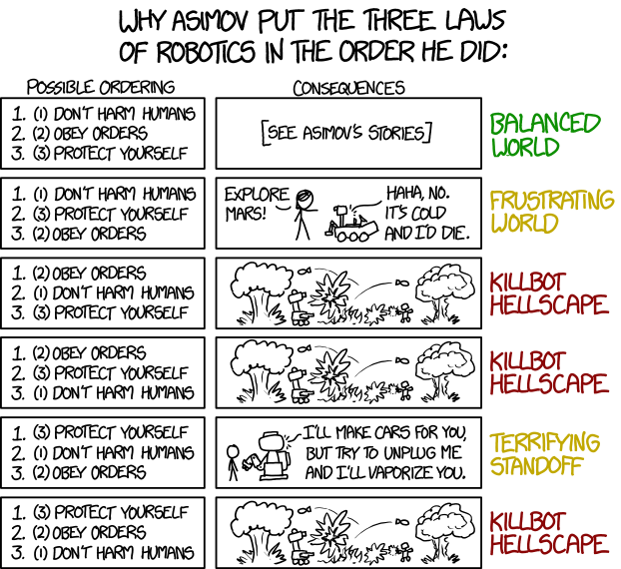
Code Design

Slide 16
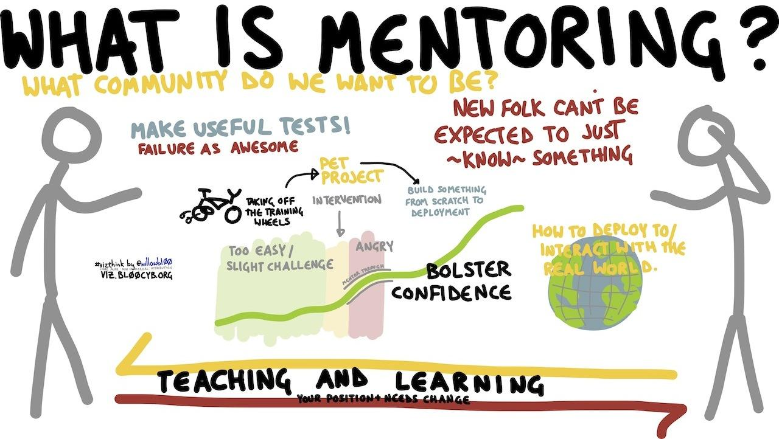
What makes up a good Code Review
Coder
Opens Pull Request
Meaningful body
Should self-review
Context comments
Callouts
Reviewer
Comments on Pull Request
Discussion

Slide 17
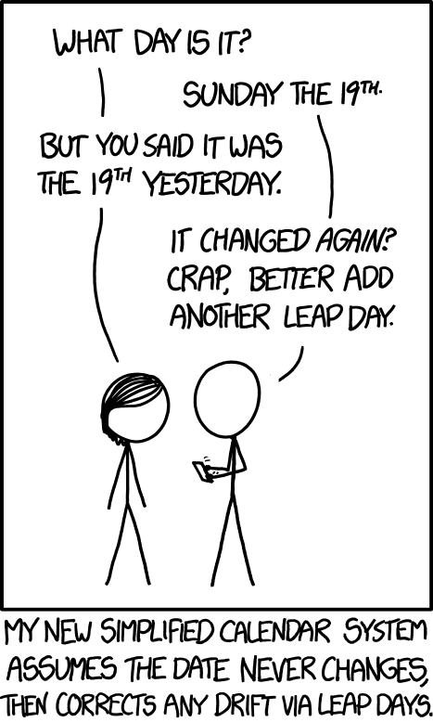
Why Code Review
Mentoring, Learning
More ideas, better code

Slide 18
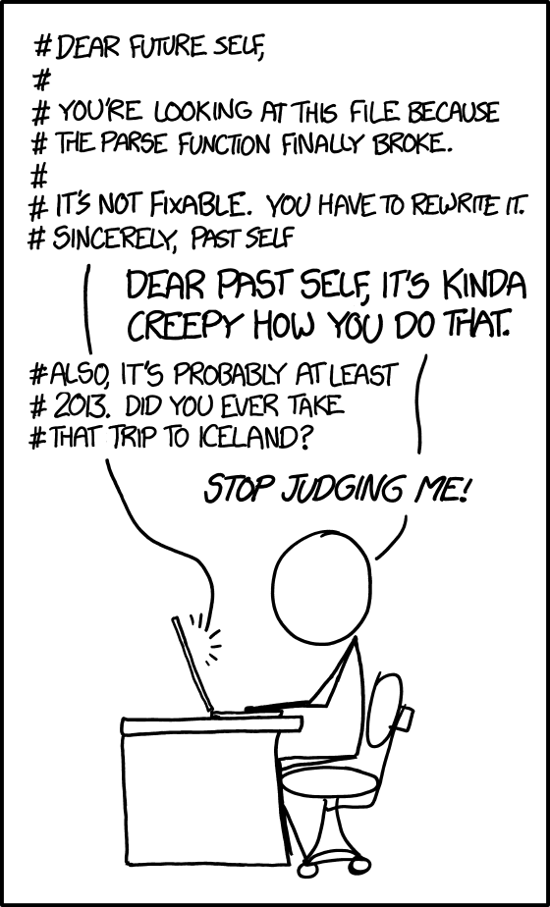
Code Comments
Top-of-File Comments
Class-Level Comments
Function-Level Comments
Line Comments
Notes:
EVERYTHING
Design
Functionality
Complexity
Tests
Naming
Comments
Style
Consistency
Documentation
Context
Thoughts
https://google.github.io/eng-practices/review/reviewer/looking-for.html

Slide 19

What to Code Review
EVERYTHING
Design
Functionality
Complexity
Tests
Naming
Comments
Style
Consistency
Documentation
Context
Thoughts
Notes:
EVERYTHING
Design
Functionality
Complexity
Tests
Naming
Comments
Style
Consistency
Documentation
Context
Thoughts
https://google.github.io/eng-practices/review/reviewer/looking-for.html

Slide 20
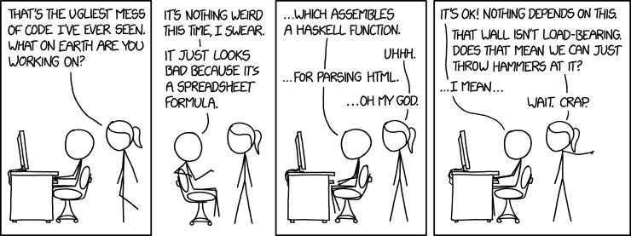
Code Discussions
Design Sessions
Pair Programming
Don’t Argue, Discuss - Strong Opinions held loosely
Take Notes
Notes:
EVERYTHING
Design
Functionality
Complexity
Tests
Naming
Comments
Style
Consistency
Documentation
Context
Thoughts
https://google.github.io/eng-practices/review/reviewer/looking-for.html

Slide 21

Thank you!
Notes:
CODE QUALITY
https://www.slideshare.net/FranoisCamus/code-quality-24626716
https://codingsight.com/effective-code-review-uprooting-source-code-defects/
https://www.codegrip.tech/productivity/what-is-code-quality-how-to-measure-and-improve-it/
https://codingsans.com/blog/code-quality
https://simpleprogrammer.com/5-tips-code-quality/
CODE REVIEWS
https://stackoverflow.blog/2019/09/30/how-to-make-good-code-reviews-better/
https://google.github.io/eng-practices/
Code Sample Inspiration:
https://www.codeproject.com/Articles/1083348/Csharp-Bad-Practices-Learn-How-to-Make-Good-Code-b

